Slide 1
Clinic Management System: A Diploma Engineering Project
Streamlining Healthcare Management with Django
Hareesh Shankar bhat
Computer Science
kle society’s C.I Munavalli polytechnic, hubballi
26 - 04 - 2025

Slide 2
Project Overview
Aims to provide a comprehensive solution for managing appointments, tracking medications, and controlling user access in a clinic environment.
• Addresses the challenges of efficient data management and secure access in modern clinics.
• Focuses on creating a user-friendly and reliable system for both healthcare providers and patients.

Slide 3
The Challenge: Inefficient Clinic Management
Manual processes for appointment scheduling and medication tracking are time-consuming and prone to errors.
• Lack of centralized data management can lead to communication breakdowns and delays in patient care.
• Inadequate security measures can compromise sensitive patient information.
• Traditional system usually lacks remote logging in access for a doctor to check the system.

Slide 4
Our Solution: A Centralized Clinic Management System
A web-based application built with Django for efficient data management and accessibility.
• Automated appointment scheduling and medication tracking to reduce errors and improve efficiency.
• Role-Based Access Control (RBAC) to ensure secure access to sensitive information.

Slide 5
Key Features: User Management
User registration with role selection (Admin, Doctor, Patient, Receptionist).
• Secure login/logout functionality.
• Role-Based Access Control (RBAC): Different roles have access to different features and dashboards.
• Password reset functionality.
• Two Factor Authentication (2FA): Added email OTP to secure the login pages.

Slide 6
Key Features: Appointment Scheduling
Intuitive appointment booking interface.
• Integration with django-flatpickr for easy date and time selection.
• Calendar views for visualizing appointments.
• Automated email reminders to patients and doctors (To implement in future)

Slide 7
Key Features: Medication Tracking
Medication management (Add, Edit, Delete medications - Admin only).
• Prescription management (Create prescriptions for patients - Doctor only).
• Medication and prescription list views.
• Patient medication history tracking.
• Quantity in stock.
• Reorder level

Slide 8


Technologies Used
Backend: Django (Python web framework)
• Database: SQLite (for development)
• Frontend: HTML, CSS, JavaScript, Bootstrap
• Date/Time Picker: django-flatpickr
• 2FA: django-otp, allauth-2fa

Slide 9
Security Implementation
Input validation to prevent XSS and other injection attacks.
• Password hashing using Django's built-in authentication system.
• Role-Based Access Control (RBAC) to restrict access to sensitive features.
• Implementation of Email OTP 2FA for login pages.

Slide 10

Implementation Details: User Authentication
Used Django's built-in authentication framework for user registration and login.
• Implemented a custom user model with role-based permissions.
• Integrated django-allauth for social authentication (optional).

Slide 11
Implementation Details: Appointment Scheduling
Created Django models for appointments and time slots.
• Implemented views for booking, viewing, and managing appointments.
• Integrated django-flatpickr for user-friendly date and time selection.

Slide 12
Implementation Details: Medication Tracking
Created Django models for medications and prescriptions.
• Implemented views for managing medications and creating prescriptions.
• Implemented basic inventory tracking.

Slide 13
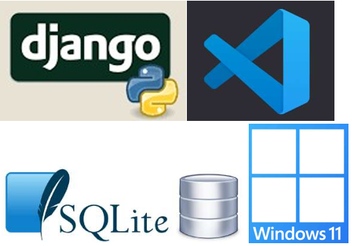

Software Applications Used
Development Environment:
Operating System: Windows, or Linux
Text Editor/IDE: Visual Studio Code (VS Code)
Python Interpreter: Python 3.13
Version Control:
Git
GitHub (Repository Hosting)
Package Management:
pip (Python Package Installer)
Database Management:
SQLite
DB Browser for SQLite (Optional)

Slide 14
Challenges Faced
Implementing RBAC
• Integrating third-party libraries
• Addressing security vulnerabilities
• Database schema design
• Circular Imports issues

Slide 15
Future Enhancements
Implement unit testing to automatically test the system
• Removing bugs and errors
• Improve the look and feel of the website, or add more functionalities to each user group (admin, doctor, patient and receptionist)

Slide 16
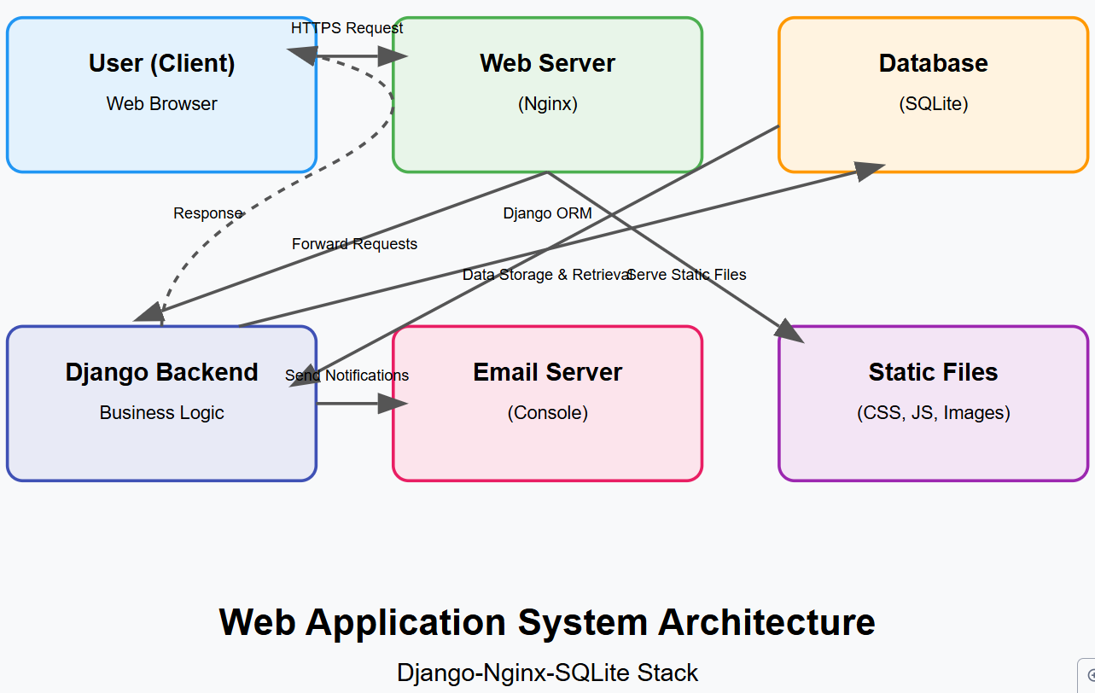
System Architecture

Slide 17
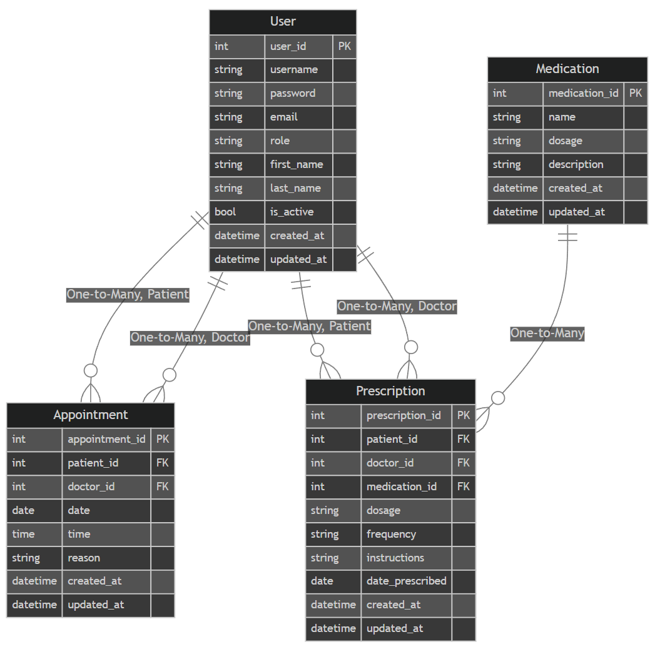
Database Design: Entity-Relationship Diagram

Slide 18
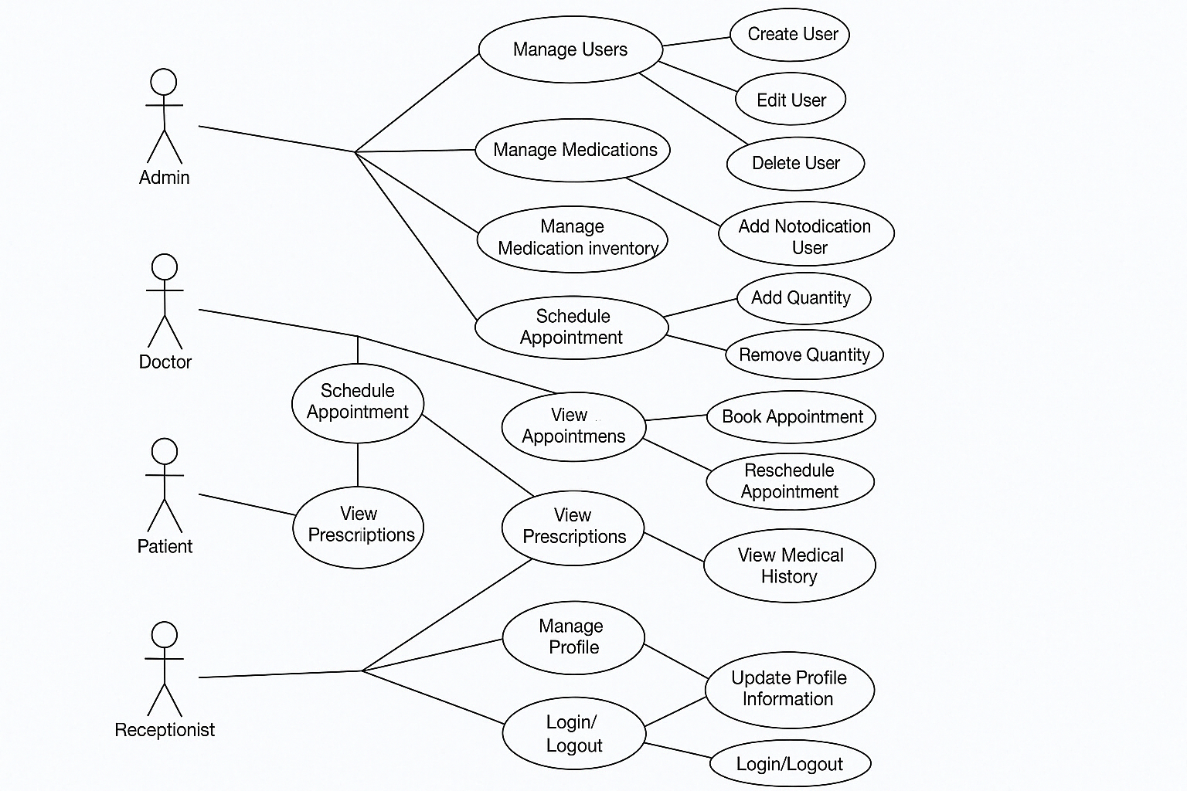
Use Case Diagram

Slide 19
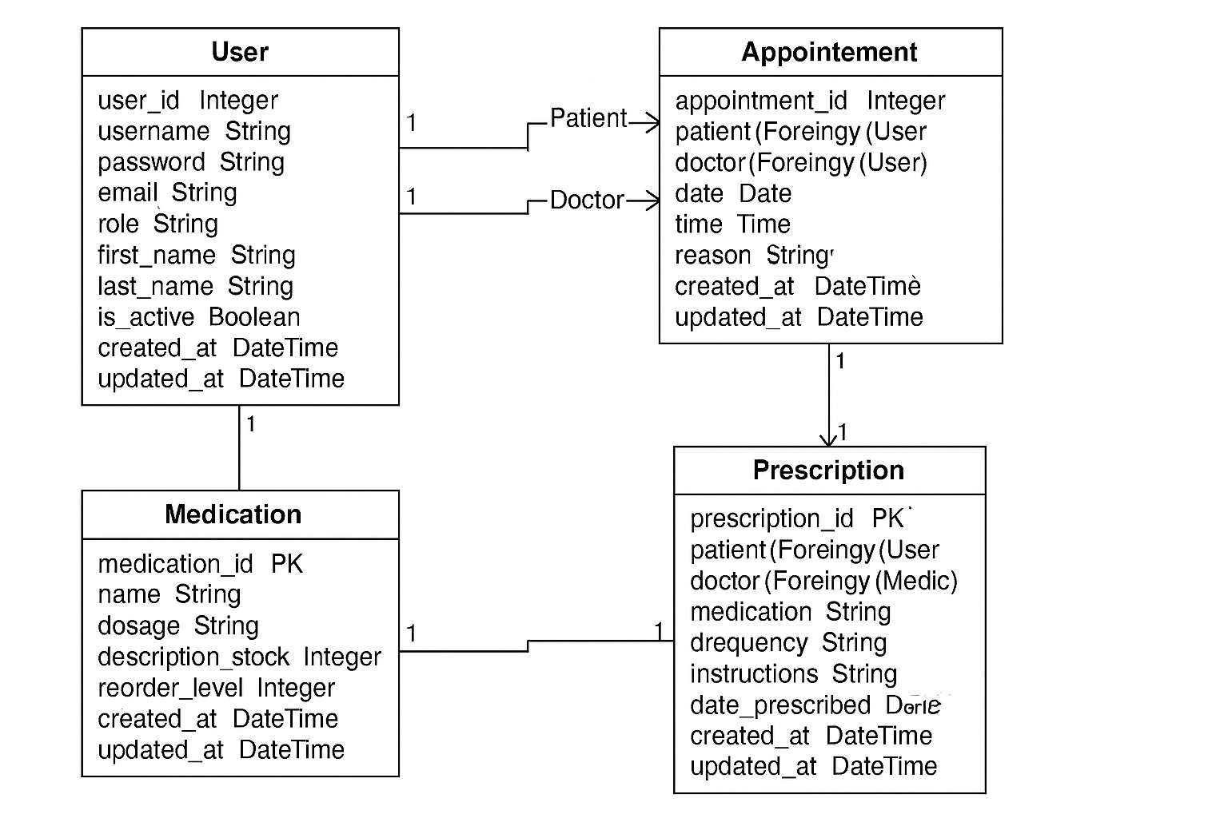
Class Diagram

Slide 20
Sources:
OWASP Foundation. (2022). SQL Injection. Retrieved from https://owasp.org/www community/attacks/SQL_Injection
Google Captcha. To Avoid bots. https://www.google.com/recaptcha/about/
Smith, J. "Protecting Django Applications from Common Cybersecurity Threats." Journal of Web Security, 10(2), 123-135.
Johnson, R., & Williams, S. "Best Practices for Secure Django Development." Proceedings of the International Conference on Cybersecurity.

Slide 21
THANK YOU🙏

